Slide 1
THE CANCER PREDICTION
USING IOT AND CLOUD TECHNOLOGY
BY:
Suhail T-2019123
Mahesh R-20139130
Praveen kumar-201391180

Slide 2
Abstract
In recent days, Internet of Things, Cloud Computing, Deep learning, Machine learning and Artificial Intelligence are considered to be an emerging technologies to solve the real world problems.
These technology are importantly applied in many fields such as healthcare, transportation and agriculture to produce fruitful results for today’s environment. This research work focuses on one such application in the field of IoT together with cloud computing.
More number of sensors are deployed in human body to collect patient related data such deviation in body temperature and others which leads to variation in blood cells that turned to be cancerous cells.
Main intention of this work is to design a cancer prediction system using IoT upon extracting the details of blood results to test whether it is normal or abnormal. In addition to this, encryption is done on the blood results of cancer affected patient and store it in cloud for quick reference.

Slide 3
Existing system
Various sensors are deployed in a human body are used to monitor the variation in the temperature and blood pressure.
These collected data are then stored using any localprocessing system which are considered to be the real clinical data. This proposed system is especially helpful for predicting the cancer hence the blood test report or mammogram report after identifying the variation in blood cells and temperature are used here for processing.
Features from the blood test report are extracted for classification since the features of a blood test may belong to a normal person or a person who is affected by a cancer.

Slide 4
LITERATURE SURVEY
This survey focuses IoT-enabled cancer prediction systems that use cloud computing for enhanced authentication and security. The papers reviewed cover topics such as cloud-based IoT in healthcare, secure authentication and data transmission mechanisms, and machine learning and deep learning algorithms for improving accuracy. Overall, the papers highlight the potential of IoT-based cancer prediction systems for improving diagnosis and treatment, while also addressing the challenges of authentication and security in these systems.

Slide 5
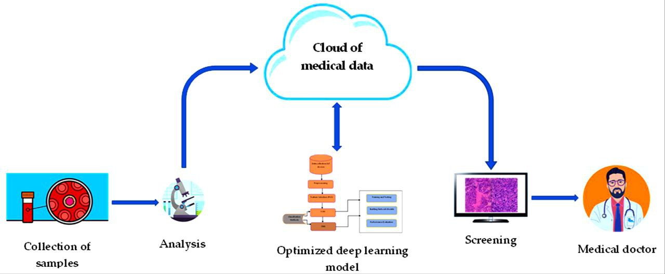
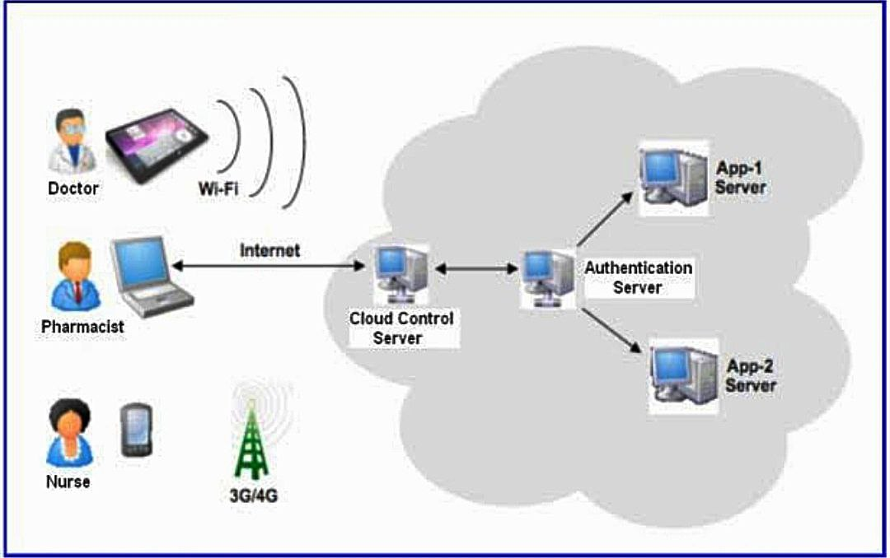
The use of cloud computing

Slide 6
PROPOSED SYSTEM
Our research work concentrates on enhancing the health care computations and processing.
Encryption and decryption is done using AES algorithm in order to provide authentication and security in handling cancer patients.
The main focus is to handle healthcare data effectively for the patient when they are away from the home town since the needed cancer treatment details are stored in cloud.
CloudSim gives an adaptable simulation structure that empowers displaying and reproduced results

Slide 7
TOOLS USED
Hardware Requirements:
3 laptops
Software Requirements:
aws, bitlocker
Other requirements:
Kaggle data set

Slide 8
MODULES
Data importing
Data cleaning
Data manipulation
Prediction
Cloud migration
Encryption and decryption

Slide 9
STATUS OF THE PROJECT
We are currently developing a cancer prediction system using IoT and cloud technology. We are in the data collection phase, where we are gathering high-quality data from various sources, including electronic health records, medical images, and patient-generated data using IoT devices. To aid in this process, we are utilizing a Kaggle dataset with relevant cancer data that we are integrating into our system. We estimate this phase to be completed by [insert estimated date]. We are excited about the progress made so far and confident in the system's potential impact. We will continue to provide regular updates on the project's progress.

Slide 10
PROJECT GUIDE MEETING DETAILS
S.NO | DATE | SUGGESTION FROM GUIDE

Slide 11
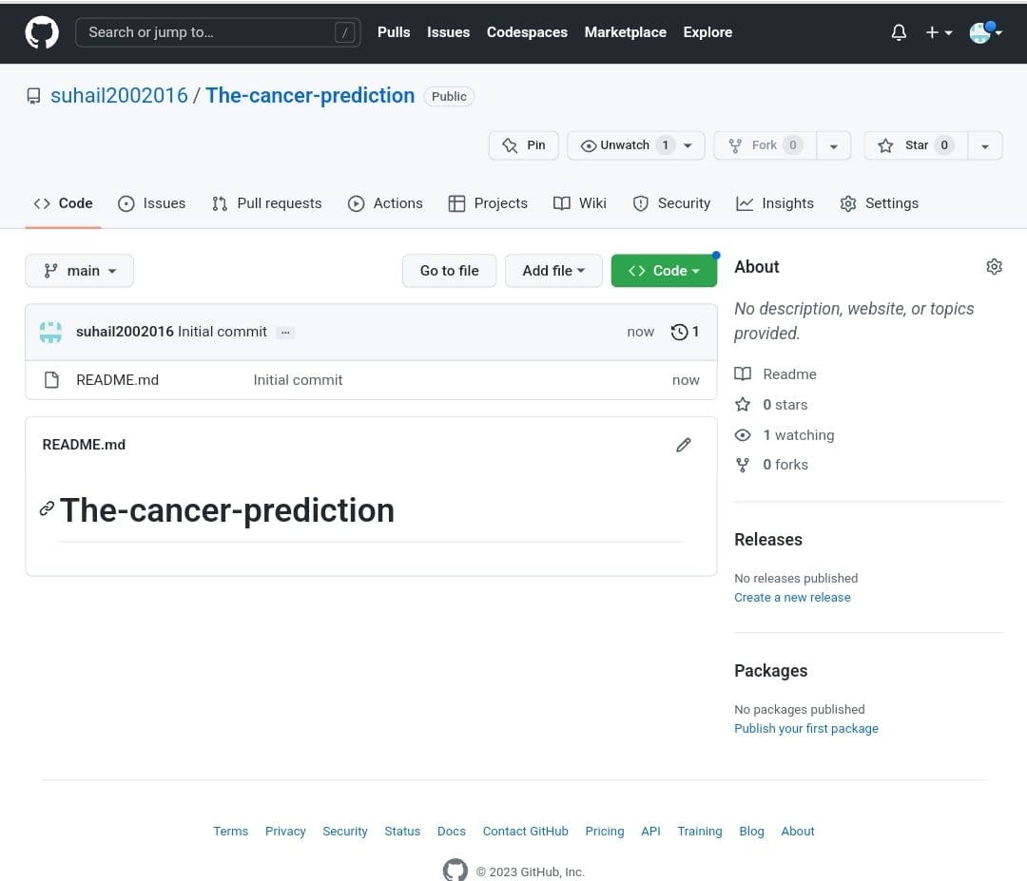
GITHUB SCREEN SHOT

Slide 12
THANKYOU

